Slide 1
Video Surveillance Anomaly Detection System on Crime using Deep Learning Approaches
Presented By:
Dhundhubi A (01JST21CB010)
Kushal Gowda K N (01JST21CB020)
Srushti Gundappa Khavatkoppa (01JST21CB041)
Yadunandan N M (01JST21CB052)
Under the Guidance of: Dr R J Prathibha
Associate Professor
Department of ISE

Slide 2
Introduction
Manual video monitoring is time-consuming and prone to error. This project introduces an intelligent surveillance system that uses deep learning to automatically detect anomalies in video feeds. By combining ResNet-18 for spatial feature extraction and LSTM for temporal pattern analysis, the system accurately classifies events as normal or suspicious. Trained on the UCF-Crime dataset, it improves response time, reduces human effort, and ensures reliable performance across various scenarios like arson, fighting, and theft.

Slide 3
Literature Survey

Slide 4
Sl. No. | Name | Place of publication | Methodology | Dataset | Anamoly detected | Limitations
1 | Video anomaly detection system using deep convolutional and recurrent models. (June 2023) | Results in engineering Volume 18, Article 101026 | CNN, Simple Recurrent Unit(SRU), ResNet18/34/50 | UCF-Crime (1900 videos) | violence | CNN and SRU can be used with the attention layer to detect anomalies more accurately.
2 | Conditioned Cooperative training for semi-supervised weapon detection. (October 2023) | Neural Networks Volume 167, Pages 489-501 | Pseudo-labelled based on the teacher model, novel threshold search technique, ResNet50 | YouTube GDD (343 videos) | weapon detection, homicides | Lack of improvement after several cycles due to imprecise annotations of unknown images.

Slide 5
Sl. No. | Name | Place of publication | Methodology | Dataset | Anamoly detected | Limitations
3 | Fighting for a future free from violence: A framework for real-time detection of “Signal for Help.” (February 2023) | Intelligent Systems with Applications Volume 17, Article 200174 | CNN , MobileNet(for recognition), ResNet50(for detection), ResNeXt101 (for Classification) | Customized dataset (Signal for Help) | violence | -A more accurate and trained dataset is required for better real-time performance. -Slightly lower accuracy than SOTA but with four times fewer resources and 50% speed up inference.

Slide 6
Sl. No. | Name | Place of publication | Methodology | Dataset | Anamoly detected | Limitations
4 | Real-world malicious event recognition in CCTV recording using Quasi-3D network. (January 2022) | Journal of Ambient Intelligence and Humanized Computing Volume 14, Pages 10457–10472 | 2D Convolution filters, 3D Convolution, ResNet | Crimes Scene Customized, Hockey Fight(1000 videos) | shooting, fighting, vandalism | -The anomalies in the data set are limited ,and the model can be further trained on diverse types of anomalies. -Characterization and removal of redundancy in the model improves the frame processing rate, which can handle anomalies effectively.

Slide 7
Sl. No. | Name | Place of publication | Methodology | Dataset | Anamoly detected | Limitations
5 | Violence Detection by Pretrained Modules with Different Deep Learning Approaches. (2020) | Vietnam Journal of Computer Science Vol. 07, No. 01, pp. 19-40 | LSTM, VGG16/19, ResNet50 | Movies | violent, panic | -Missed to detect violence triggering behavior. -Smaller dataset yields marginal overfitting
6 | Vision transformer attention with multi reservoir echo state network for anomaly recognition. ( May 2023) | Information Processing & Management Volume 60, Issue 3, Article 103289 | Sequential learning (ESN), Vision transformer, multiple reservoirs with an attention mechanism, FPGM (Filter Pruning via Geometric Median) | UCF-Crime (1900 videos), LAD-2000 (2000 videos) | vandalism, road accidents | Intra-class similarity, occlusion, insufficient illumination and background clutter resulted in misprediction of some classes

Slide 8
Sl. No. | Name | Place of publication | Methodology | Dataset | Anamoly detected | Limitations
7 | Sequential attention mechanism for weakly supervised video anomaly detection. (November 2023) | Expert Systems with Applications Volume 230, Article 120599 | DCNN, TCN (Temporal Convolution Neural Network), attention mechanism BotNet-152 | UCFCrime2local (300 videos), LAD-2000 (2000 videos), RWF-2000 (2000 videos), RLVS (2000 videos), Crowd Violence (246 videos) | All anomalies of the mention ed datasets | Mis predicted two classes due to occlusion, fixed camera position and strong resemblance of the actions
8 | Fighting against terrorism: A real-time CCTV autonomous weapons detection based on improved YOLO v4 (January 2023) | Digital Signal Processing Volume 132, Article 103790 | Yolo v4,ResNet, multi scale dilation | Synthetic Datasets | weapon detection | The performance of using a synthetic dataset in the model has not been thoroughly investigated

Slide 9
Sl. No. | Name | Place of publication | Methodology | Dataset | Anamoly detected | Limitations
9 | RareAnom: A Benchmark Video Dataset for Rare Type Anomalies. Pattern Recognition (August 2023) | Pattern Recognition Volume 140, Article 109567 | 3D CAE, Latent features, Isolation Forest (iForest), OC-SVM | RareAnom Customized, UCFCrime (1900 videos), XDViolence (4754 videos) | violenc e, abuse, kidnap ping, train accide nts, abando n baggag e, drowni ng | -RareAnom is closed-set, thus challenging against various benchmarks that work on open- set datasets. -Using DL in the 3D-CAE stage could augment the detection accuracy. -DL instead of pseudo labels can yield intermediate solid labels. -The initial detection stage requires testing on supervised methods to get better performance, but the model is unsupervised.

Slide 10
Sl. No. | Name | Place of publication | Methodology | Dataset | Anamoly detected | Limitations
10 | Intelligent dual stream CNN and echo state network for anomaly detection. (October 2022) | Knowledge-Based Systems Volume 253, Article 109456 | ESN,2D CNN (for anomaly detection), 3D visual features extraction, autoencoder (EfficientNetB7) | UCFCrime (1900 videos), ShanghaiTech (437 videos), Surveillance Fight (300 videos), Hockey- Fight (1000 videos), Violent Flow (246 videos) | violence | -Not handling the relationships among the objects accurately - 2DCNN with autoencoder (EfficientNetB7) used to enhance features and consider optimized features only instead of using all features in ESN; thus, it resulted in crucially poor performance as the data contains complex patterns and spatial details, and optimized features caused information loss

Slide 11
Sl. No. | Name | Place of publication | Methodology | Dataset | Anamoly detected | Limitations
11 | Extracting the pickpocketing information implied in the built environment by treating it as the anomalies. (December 2023) | Cities Volume 143, Article 104575 | ResNet50, SHAP (Shapley Additive Explanations) | Customized POI (Point of Interest) Dataset | pick pocketing | -Focused on crime risk analysis rather than evaluating actual crime rates. -A dataset with fine details (census, travel survey, and trajectory) is required. -The proposed model can be implemented on global street view datasets as economic models are used to analyze unusual behaviors and their spatiotemporal correlations at micro-levels.

Slide 12
Sl. No. | Name | Place of publication | Methodology | Dataset | Anamoly detected | Limitations
12 | Semantic multimodal violence detection based on local-to-global embedding . (December 2022) | Neurocomputing Volume 514, Pages 148-161 | Deep learning, Multimodal fusion, Local- to-Global embedding, ResNet50, optical flow | CrowdViolence (246 videos) , HockeyFight (1000 videos), RWF-2000 (2000 videos), RLVS (2000 videos) | Violence (abuse, cold arms, blood, firearm s, explosi on, fightin g) | Including different external knowledge to fit into more complex scenarios and address anomaly localization tasks can help strengthen performance
13 | Anomaly recognition from surveillance videos using 3D convolution neural network. (Febuary 2021) | Multimedia Tools and Applications, Volume 80, pages 18693–18716 | 3DCNN, Pre-crime behavior method | UCFCrime (1900 videos) | Snatching | Limited to detect suspicious activity other than snatching (burglary, stealing, arson intents)

Slide 13
1. Manual Monitoring Dependency: Prone to human error and inefficiency, especially in large-scale networks. 2. Poor Anomaly Categorization: Difficulty in accurately classifying subtle or complex anomalies. 3. High Computational Requirements: Many systems require significant processing power, limiting use in edge or low-resource environments. 4. Reduced Practical Usability: Inadequate tools for administrators to review and respond to flagged events efficiently.
Limitations of existing systems

Slide 14
Despite significant progress in traditional and deep learning methods, there is still no definitive solution for video surveillance anomaly detection systems that can effectively handle large datasets containing various types of anomalies and their variations. In addition to limitations in existing detection approaches, system administrators often lack proper software tools to monitor and review flagged anomalies. This project aims to develop an efficient, lightweight automated system capable of detecting anomalies in video data and providing essential tools for effective monitoring and analysis.
Problem statement

Slide 15
Objectives
To build a lightweight and effective deep learning model for analyzing pre-recorded video data and identifying abnormal events.
To train the model on a balanced dataset covering diverse normal and abnormal behaviors for accurate anomaly classification.
To utilize ResNet-18 for spatial feature extraction and integrate temporal modeling for detecting activity-based anomalies.
To ensure efficient processing of large video datasets without relying on high-end hardware or constant human supervision.
To design a user-friendly alert interface for timely review, interpretation, and response to flagged anomalies.

Slide 16
Processing large volumes of video data efficiently with limited computational resources
Accurately detecting subtle anomalies in complex real-world scenarios
Designing an optimized model to capture both spatial and temporal features
Limited availability of labeled, balanced datasets for robust training
Building a lightweight, user-friendly interface for anomaly review
Challenges

Slide 17
Requirement Specification

Slide 18
Model Training: Kaggle Notebooks with GPU
System Specs: Intel i5/Ryzen 5+, 8–16 GB RAM, SSD 256 GB+, Windows 10/11 or Ubuntu
Display: 1080p monitor for visualizing results
Hardware requirements

Slide 19
Language: Python 3
Framework: TensorFlow
Libraries: OpenCV, NumPy, OS
Interface: Python-based GUI (no web frameworks)
Tools: Jupyter Notebook (Kaggle), Anaconda (optional for local dev)
Software requirements

Slide 20
Video Preprocessing: Clean and prepare raw video by removing noise, adjusting brightness/contrast, and applying background subtraction to focus on meaningful motion.
Feature Extraction Using Deep Learning: Use CNNs (like ResNet-18) to capture spatial features from frames, and LSTM to model changes across frames, enabling deeper scene understanding.
Anomaly Classification and Scoring: Classify events into categories (e.g., arson, explosion, fighting, stealing) and assign an anomaly score indicating the severity or confidence of detection.
Alert Generation and Logging: Trigger real-time alerts (via email/SMS) when an anomaly is detected, and maintain visual summaries and logs to support security response and auditing.
Interactive User Interface: Provide a clean interface for security personnel to view live feeds, review flagged events, and easily interpret results for faster decision-making.
Functional requirements

Slide 21
1. Performance: The system should process video feeds with minimal latency to ensure real-time anomaly detection. It should handle high-resolution and high-frame-rate video streams efficiently. 2. Accuracy: The system should achieve high accuracy in detecting and categorizing anomalies. It should minimize false positives and false negatives. 3. Reliability: The system should be reliable and operate continuously without significant downtime. It should have mechanisms to recover from failures and continue operation. 4. Usability: The user interface should be intuitive and easy to use for security personnel. The system should provide clear and actionable insights to users.
Non-functional requirements

Slide 22
5. Security: The system should ensure the security and privacy of video data. It should have access controls to prevent unauthorized access to the system. 6. Scalability: The system should be scalable to support large-scale surveillance networks with numerous cameras. It should be able to handle increasing amounts of data as the network grows. 7. Maintainability: The system should be easy to maintain and update with new features or improvements. It should have comprehensive documentation for maintenance and troubleshooting.
Non-functional requirements

Slide 23
Design

Slide 24
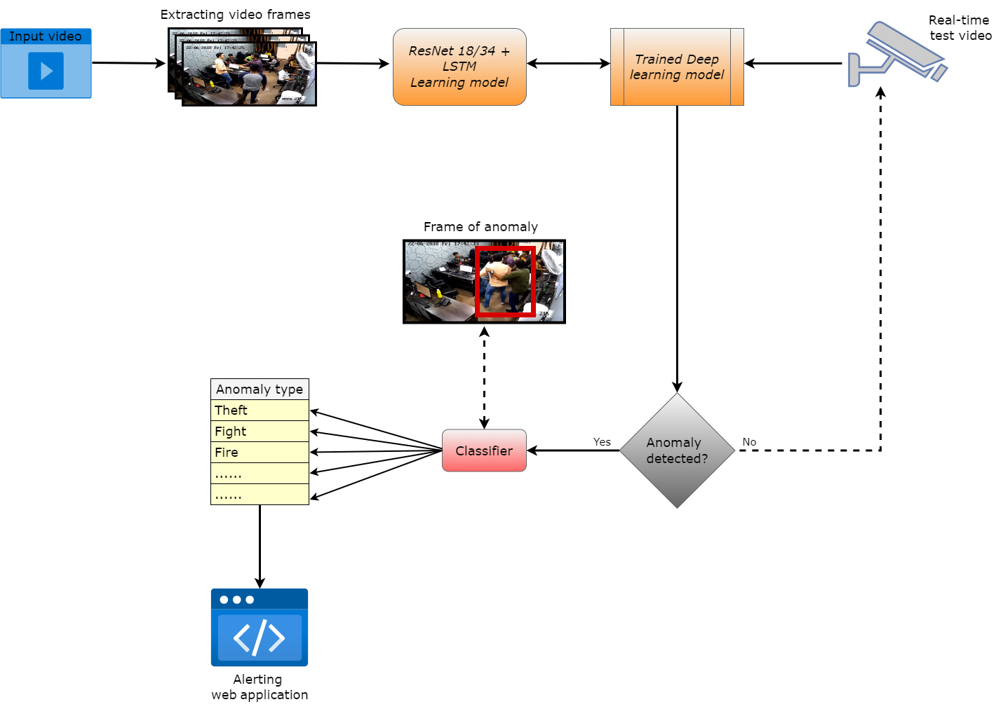
High level design

Slide 25
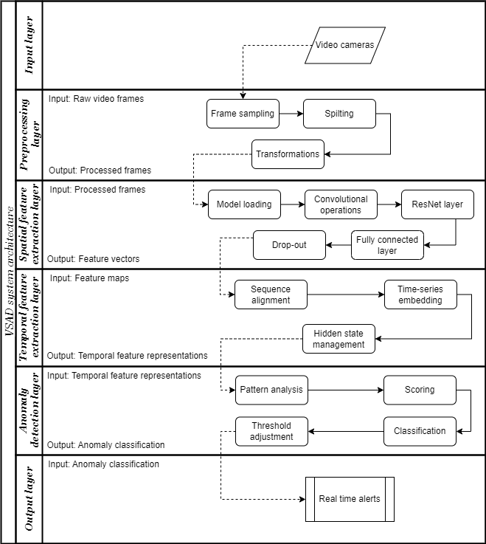
Low level design
It comprises six layers, each contributing to real-time anomaly detection. The Input Layer captures video streams from cameras, providing raw data. The Preprocessing Layer extracts frames at intervals to optimize data processing. The Spatial Feature Extraction Layer uses CNNs like ResNet to identify key visual patterns, while the Temporal Feature Extraction Layer employs LSTMs to analyze motion and behavioral trends across frames. The Anomaly Detection Layer identifies, scores, and classifies unusual events, and the Output Layer delivers real-time alerts, detailed reports, and recorded events for actionable insights.

Slide 26
Implementation

Slide 27
The Video Anomaly Detection System uses a deep learning pipeline combining ResNet-18 for spatial feature extraction and LSTM for temporal analysis. It processes 100 grayscale frames per video resized to 64×64 pixels from a labeled subset of the UCF-Crime dataset. The extracted spatial and temporal features are combined and classified into four anomaly types—Arson, Explosion, Fighting, or Stealing—using a fully connected layer trained with cross-entropy loss. This approach effectively detects abnormal activities by capturing both visual details and their changes over time.
Methodology

Slide 28
The system preprocesses each input video by extracting 100 evenly spaced grayscale frames, resized to 64×64 pixels to reduce computational load. Each frame is labeled according to the video’s category—Arson, Explosion, Fighting, or Stealing—and grouped accordingly. Using a balanced subset of the UCF-Crime dataset, only the most relevant video segments with clear anomalies are selected. This approach reduces redundancy and training time while preserving essential spatial and temporal information for accurate crime detection.
Video Processing Layer

Slide 29
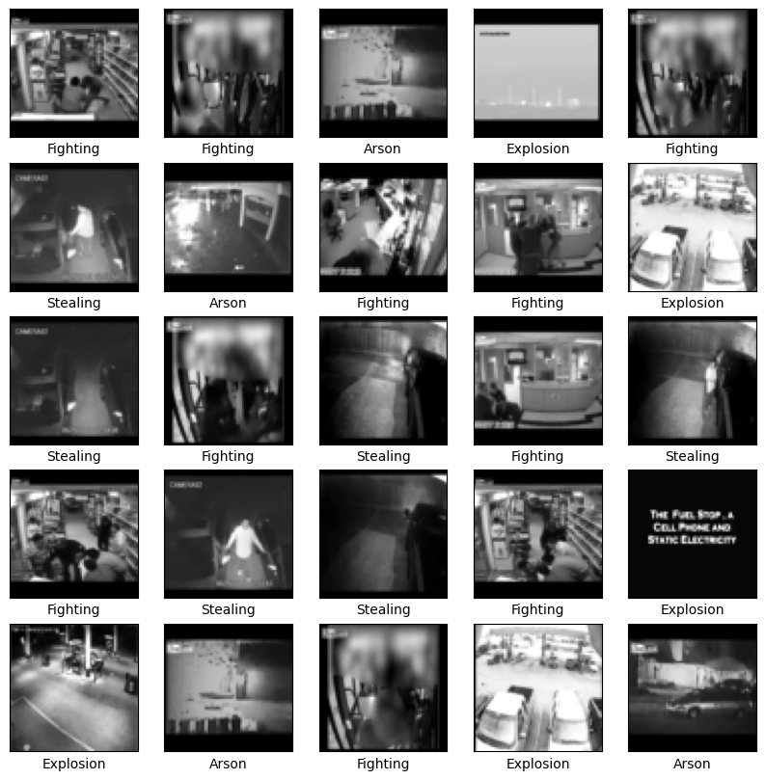
Output of video processing layer

Slide 30
Spatial features are extracted from grayscale video frames using a modified ResNet-18 model, adapted to accept single-channel input. Leveraging transfer learning from a pre-trained ImageNet model accelerates training and improves feature extraction. The final layer is replaced with a custom layer producing a 512-dimensional vector representing spatial details such as textures, edges, and objects crucial for anomaly detection.
ResNet-18 CNN Model

Slide 31
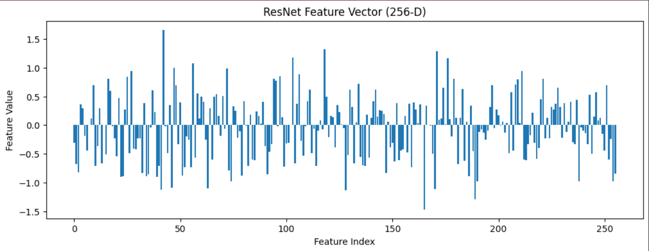
256- dimensional vector for a sample image frame

Slide 32
The LSTM network captures temporal dependencies by processing sequences of frame features. Flattened frame vectors are passed through two LSTM layers with 128 hidden units, modeling motion and changes over time. This temporal modeling helps identify dynamic events like fighting or explosions by understanding how frames evolve, distinguishing normal from suspicious activities effectively.
LSTM Layer

Slide 33
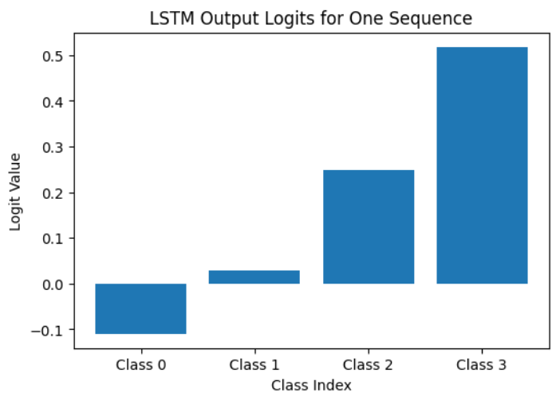
Probability of input sequence belonging to certain class

Slide 34
Outputs from the ResNet (512-dimensional) and LSTM (128-dimensional) layers are concatenated into a 640-dimensional feature vector. This combined vector is fed into a fully connected layer that classifies the video segment into one of four anomaly categories: Arson, Explosion, Fighting, or Stealing. Training uses a cross-entropy loss function, allowing the model to accurately map features to anomaly types by integrating spatial and temporal information.
Classification Layer

Slide 35
A curated subset of the UCF-Crime dataset was used, focusing on four anomaly classes: Arson, Explosion, Fighting, and Stealing. For each class, 50 representative videos were selected for training and testing. Grayscale frames were extracted every 10 frames and resized to 64×64 pixels to reduce computational complexity. The training set contained about 19,000 images evenly distributed across classes, while the test set included 1,000 images. This ensured balanced data and minimized noise, providing an efficient foundation for anomaly detection.
Dataset Details and Splits

Slide 36
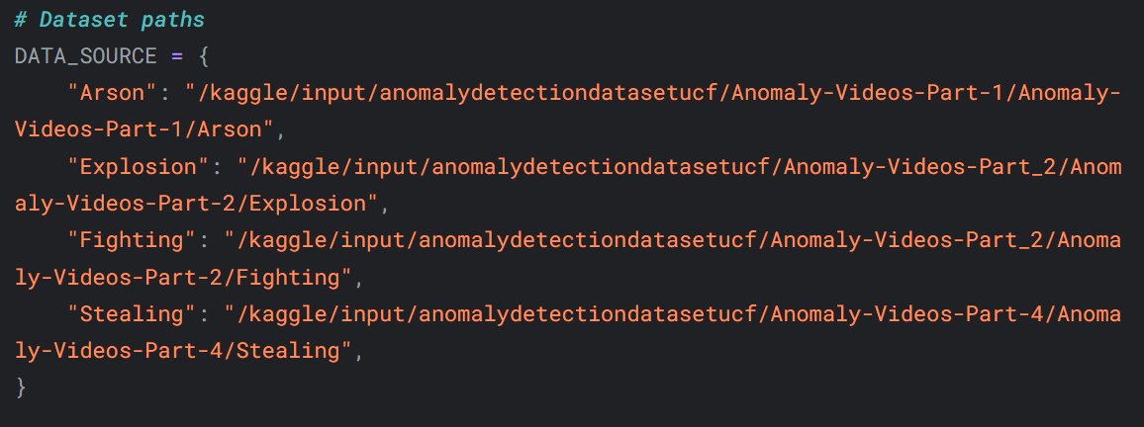
Dataset path added for training

Slide 37
The model was trained using a hybrid CNN-LSTM architecture with a modified ResNet-18 for spatial features and two LSTM layers for temporal dependencies. Training ran up to 15 epochs with early stopping at epoch 5 to avoid overfitting. A batch size of 64 and Adam optimizer with a learning rate of 0.001 were used. Transfer learning with ImageNet-pretrained weights accelerated training. The process was executed on a Kaggle Notebook using GPU for faster computation.
Training Setup

Slide 38
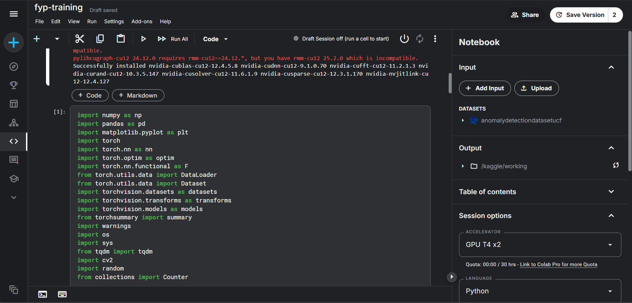
Training setup(Kaggle notebook)

Slide 39
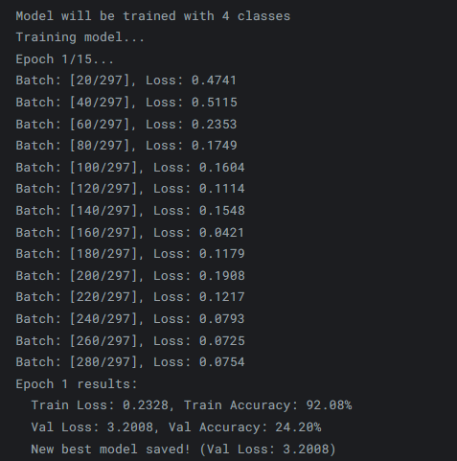
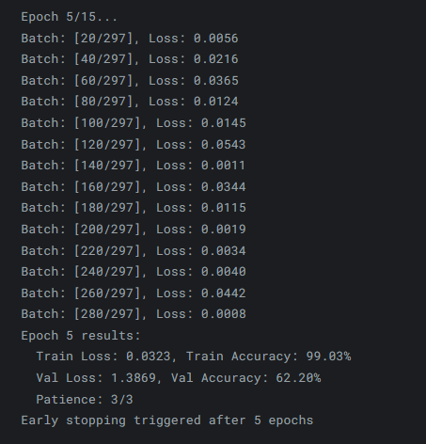
Training the model(first epoch) and saving the best model
Early stopping of the training process

Slide 40
Results and Discussion

Slide 41
Training accuracy rose quickly, reaching over 99% by epoch 5, while validation accuracy improved to 75.5% but plateaued, triggering early stopping. Loss curves showed rapid convergence with stable training loss but fluctuating validation loss, indicating some challenges in generalizing to unseen data. Overall, the model effectively learned spatial-temporal patterns during training.
Training and Validation Curves

Slide 42
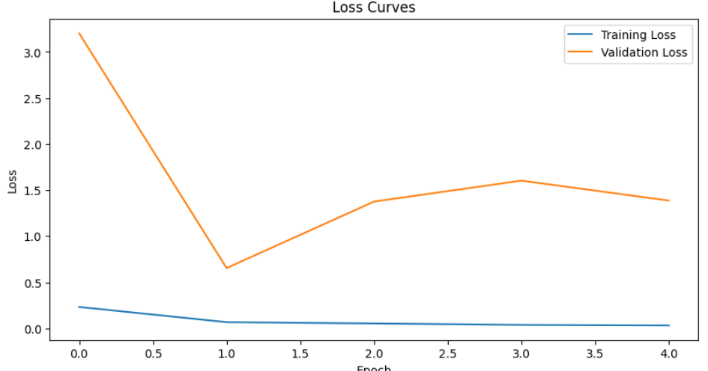
Loss Curves

Slide 43
On the test set, the model achieved 62.20% accuracy in classifying four anomaly categories. Arson and Stealing were identified with high recall, while Explosion and Fighting showed misclassifications due to similar visual features. The confusion matrix highlighted these overlaps, revealing strengths and limitations in the model’s classification ability.
Test Set Evaluation

Slide 44
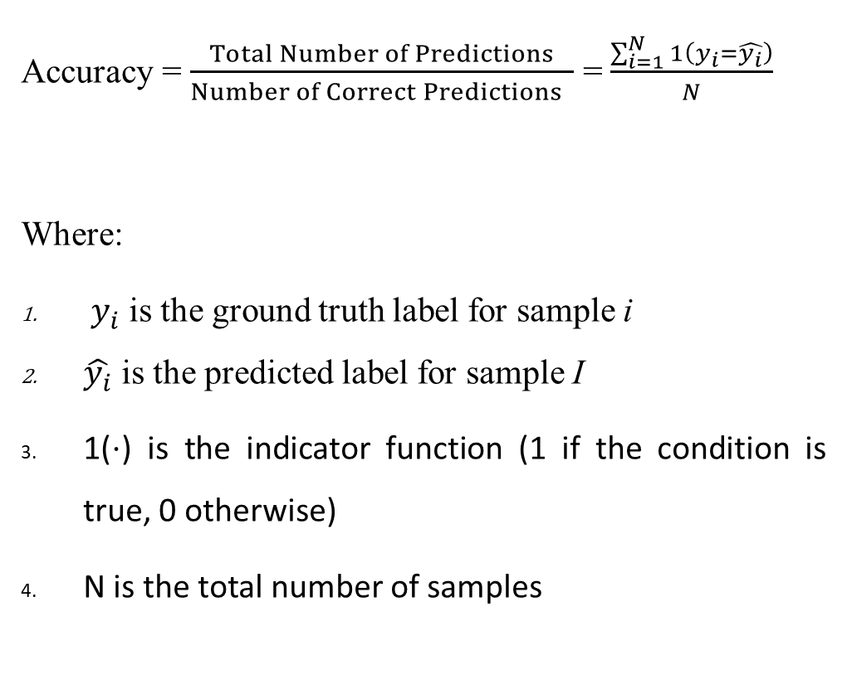
Accuracy = $\frac{Total Number of Predictions}{Number of Correct Predictions ​ }$ =$\frac{\sum_{i=1}^{N}{1}\left(y_{i}=\hat{y_{i}}\right)}{N}$
Where:
$y_{i}$ is the ground truth label for sample i
$\hat{y_{i}}$ is the predicted label for sample I
1(⋅) is the indicator function (1 if the condition is true, 0 otherwise)
N is the total number of samples

Slide 45
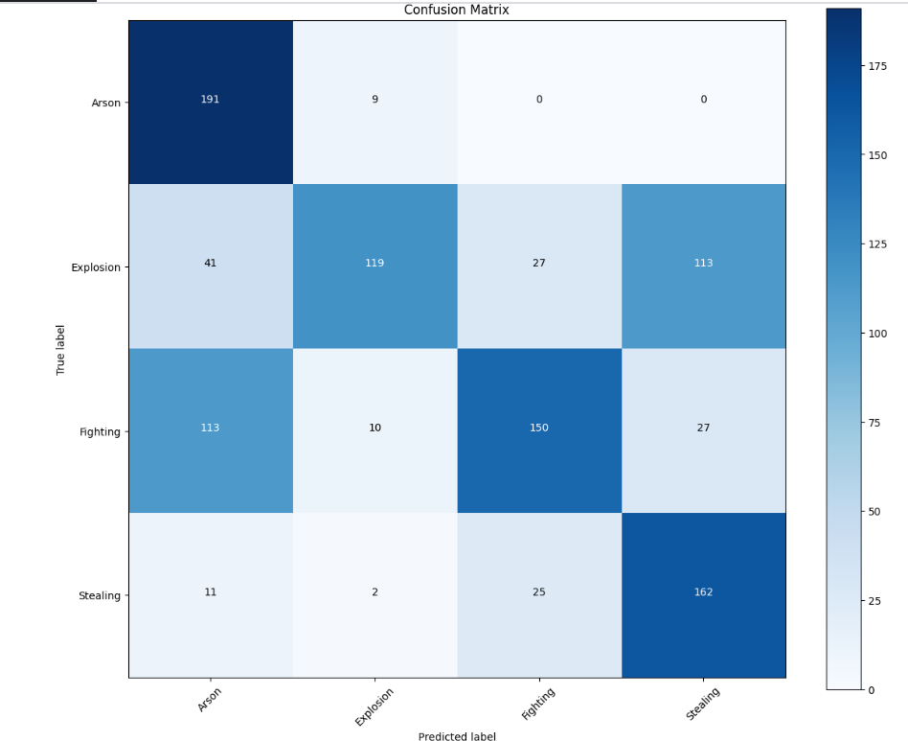
Confusion Matrix

Slide 46
To evaluate the model's performance on each anomaly type—Arson, Explosion, Fighting, and Stealing—Precision, Recall, and F1 Score were computed. Precision reflects how many predicted positives were correct, while Recall shows how many actual instances were identified. The F1 Score balances both. The model showed high recall (0.9550) but low precision (0.5365) for Arson, meaning it detects most cases but with some false alarms. Explosion had high precision (0.8500) but low recall (0.3967), indicating accurate predictions but many missed cases. Fighting and Stealing showed more balanced scores. These metrics highlight strengths and weaknesses across classes, guiding further model improvement.
Per-class metrics

Slide 47
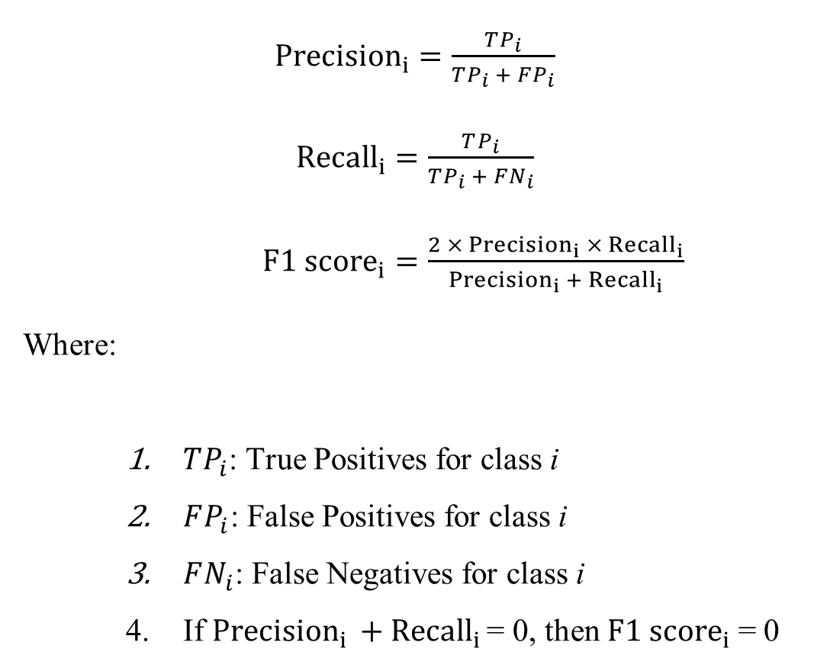
${Precision}_{i}=\frac{TP_{i}}{TP_{i} + FP_{i}}$
${Recall}_{i}=\frac{TP_{i}}{TP_{i} + FN_{i}}$
${F1 score}_{i}=\frac{2 ×{ Precision}_{i} ×{ Recall}_{i}}{{Precision}_{i }+{ Recall}_{i}}$
Where:
$TP_{i}$​: True Positives for class i
$FP_{i}$​: False Positives for class i
$FN_{i}$: False Negatives for class i
If ${Precision}_{i }+{ Recall}_{i }$= 0, then ${F1 score}_{i}$= 0

Slide 48
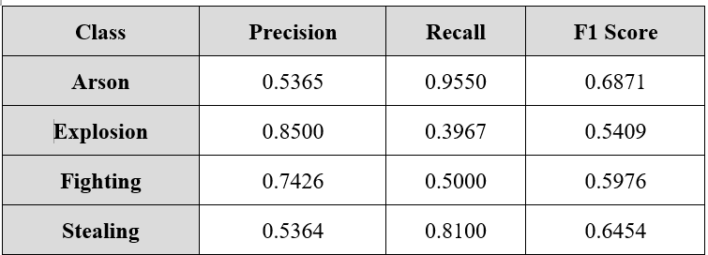
Precision, Recall, F1 score values for each class

Slide 49
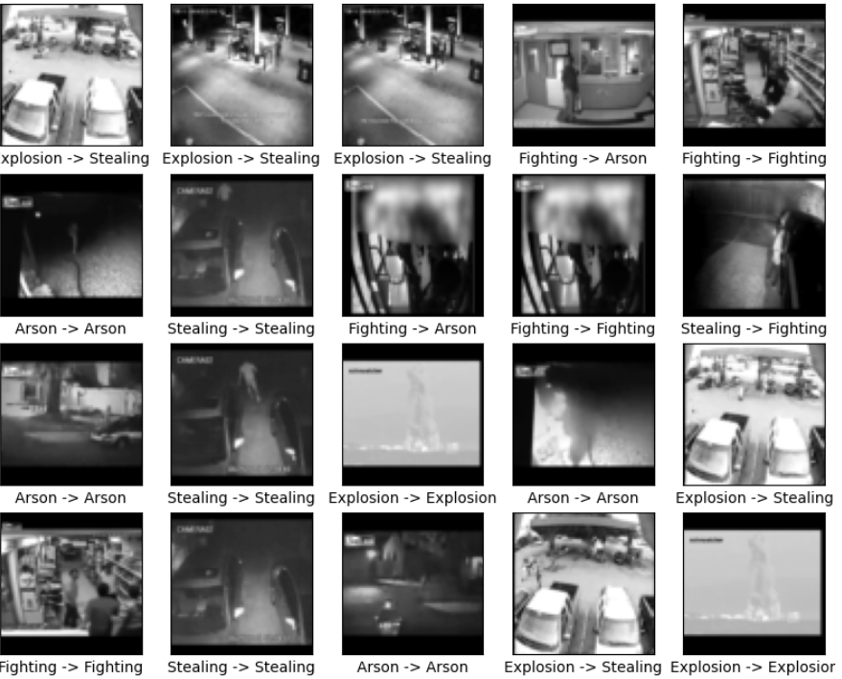
Prediction results for anomaly classification

Slide 50
The developed interface provides a streamlined environment for processing surveillance videos and identifying anomalous events. Users can upload video files, which are then analyzed frame by frame using the trained CNN-LSTM model. The interface displays the video alongside a panel indicating the current detection status, including the anomaly type and the corresponding confidence score. Additionally, a detailed activity log tracks important system events such as model initialization, video frame processing, detection outputs, and completion status. This structured layout allows users to clearly observe the detection flow and review significant occurrences identified during video analysis.
Anomaly Detection Interface

Slide 51
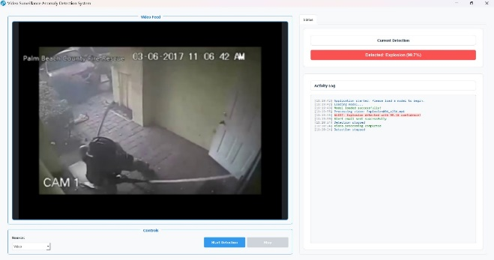
Anomaly Detection Interface

Slide 52
An integrated email notification system enhances the responsiveness of the anomaly detection framework. When the model identifies a suspicious event with a high confidence level, the system automatically generates and sends an alert email to the designated recipient. The email includes critical information such as the type of anomaly, the exact timestamp, the confidence score, and a snapshot of the frame where the event was detected. For example, in one case, the system detected an explosion with 99.1% confidence and immediately issued a visual alert via email. This prompt communication mechanism ensures timely attention to detected incidents, supporting rapid response and documentation.
Email Alert System

Slide 53
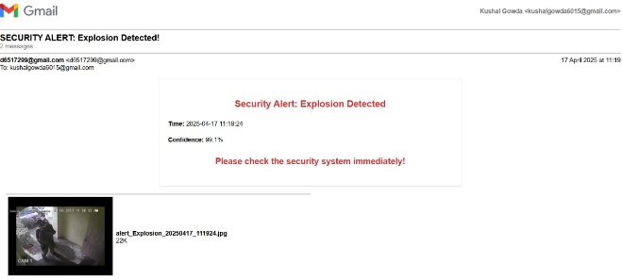
Email Alert System

Slide 54
This project presents a deep learning-based system using ResNet-18 and LSTM for detecting anomalies in surveillance videos. Trained on selected UCF-Crime categories, the model achieved 62% accuracy in identifying Arson, Explosion, Fighting, and Stealing. Though real-time detection is not included, the system demonstrates effective anomaly classification and triggers email alerts, laying the foundation for future real-time and multi-class enhancements.
Conclusion

Slide 55
Real-time Anomaly Detection: Incorporate live video stream processing for immediate identification of suspicious activities.
Expand Anomaly Categories: Train the model on a broader range of anomaly types beyond Arson, Explosion, Fighting, and Stealing.
Improve Accuracy: Enhance performance through better data preprocessing, hyperparameter tuning, or more advanced model architectures.
Integrate Attention Mechanisms: Use attention layers to help the model focus on critical frames, improving detection precision.
Future Work

Slide 56
[1] M. Asim and E. Verdu, "Video anomaly detection system using deep convolutional and recurrent models," Results Eng., vol. 17, 2023. [2] J. L. S. Gonzalez, J. A. Alvarez-Garcia, F. J. Rendon-Segador, and F. Carrara, "Conditioned cooperative training for semi-supervised weapon detection," Neural Netw., vol. 164, pp. 294–305, 2023. [3] K. V. Hakare, D. P. Dogra, H. Choi, H. Kim, and I. J. Kim, "RareAnom: A benchmark video dataset for rare type anomalies," Pattern Recognit., vol. 137, 2023. [4] A. Mahmood, "Abnormal behavior detection in uncrowded videos with two-stream 3D convolutional neural networks," Appl. Sci., vol. 11, no. 9, 2021.
References

Slide 57
[5] A. Man and G. M. Khan, "Real-world malicious event recognition in CCTV recording using Quasi-3D network," J. Ambient Intell. Humaniz. Comput., vol. 13, pp. 1245–1259, 2022. [6] S. Mishra and S. Mishra, "Anomaly recognition from surveillance videos using 3D convolution neural network," Proceedings of the 6th International Conference on Communication and Electronics Systems (ICCES), pp. 1102–1107, 2021. doi: 10.1109/ICCES51350.2021.9488972 [7] S. Ozimi, D. D. Sio, F. Carlucci, and L. Sterpone, "Fighting for a future free from violence: A framework for real-time detection of 'Signal for Help'," Intell. Syst. Appl., vol. 15, 2023. [8] G. Tang, H. Ding, M. Duan, Y. Pu, Z. Yang, and H. Li, "Fighting against terrorism: A real-time CCTV autonomous weapons detection based on improved YOLO v4," Digit. Signal Process., vol. 134, 2023.
References

Slide 58
[9] W. Ullah, T. Hussain, and S. W. Baik, "Vision transformer attention with multireservoir echo state network for anomaly recognition," Inf. Process. Manag., vol. 60, no. 3, 2023. [10] W. Ullah, F. U. M. Ullah, Z. A. Khan, and S. W. Baik, "Sequential attention mechanism for weakly supervised video anomaly detection," Expert Syst. Appl., vol. 213, 2023. [11] W. Ullah, T. Hussain, Z. A. Khan, U. Haroon, and S. W. Baik, "Intelligent dual stream CNN and echo state network for anomaly detection," Knowl.-Based Syst., vol. 249, 2022. [12] S. A. Umon, R. Goni, N. B. Hashem, M. T. Shahria, and R. M. Rahman, "Violence detection by pretrained modules with different deep learning approaches," Vietnam J. Comput. Sci., 2019. [13] Y. Yao, A. Dong, Z. Liu, Y. Jiang, Z. Guo, J. Cheng, Q. Guan, and P. Luo, "Extracting the pickpocketing information implied in the built environment by treating it as the anomalies," Cities, vol. 139, 2023.
References

